Slide 1
Suicide Rates Overview 1985 to 2016
- Compares socio-economic info with suicide rates by year and country
SRILAKSHMI BODDULURU
DSC - 530

Slide 2
Questions I am planning to focus on: 1. Is there any relation between the suicide rates and gdp (developed/developing countries)? 2. Does the above relation change if we consider age group? 3. Which age group is experiencing highest suicide rates in the recent times? 4. What are the various factors affecting the suicide number?
To answer the above questions I have selected the following variables from the dataset.
age : Age of the population divided into different age groups
15-24 years
25-34 years
35-54 years
55-74 years
75+ years
suicides_no : suicides number per country per year
population : population per country per year
suicides/100k pop : suicides number per 100k population per country per year
HDI for year: A composite index measuring average achievement in three basic dimensions of human development—a long and healthy life, knowledge and a decent standard of living.
gdp_per_capita ($): gdp per capita per country per year

Slide 3
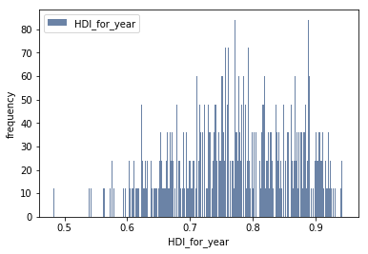
I would like to histograms for the variables to find out the distribution of data: Histogram of HDI_for_year:
After finding out the smallest and highest values for the data and calculating the mean, mode, var, std of HDI_for_year I don’t find any outliers for this data. The smallest peak is possibly due to low values of HDI per year. Mean and mode of HDI_for_year: 0.7766011477761785 0 0.713 . The distribution is not exactly normal distribution.

Slide 4
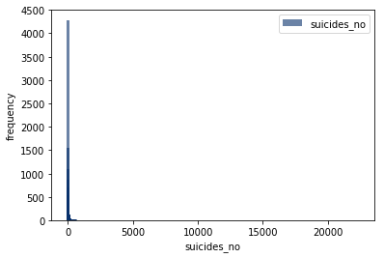
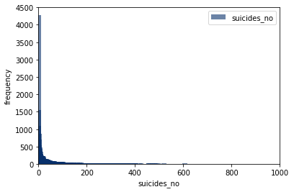
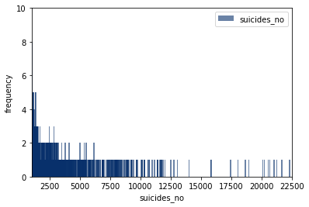
Histogram of suicides_no:
Fig.1
Fig.2
Fig.1 shows the histogram with out adding limits. Figs.2&3 shows the histogram with different limits to visualize the distribution clearly. From the diagrams it is evident that as the suicide number increases the frequency decreased. We can not consider them as outliers because it depends on various factors. The distribution is heavily positively skewed.
Fig.3

Slide 5
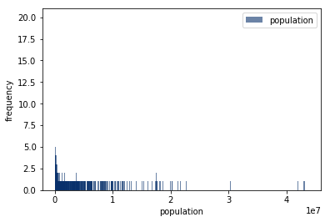
Histogram of population:
The diagram shows the histogram of population. Smallest values represents the lowest populated countries and highest values represent the highest populated countries. I couldn’t find any outliers in this as well. This is also positively skewed distribution.

Slide 6
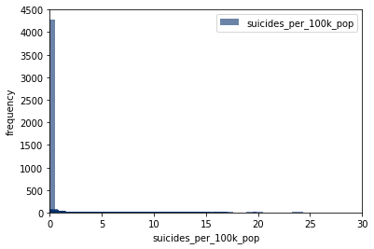
Histogram of suicides_per_100k_pop:
The diagram shows the histogram of suicides_per_100k_pop. From the diagram we can conclude that frequency of lowest number of suicides is very high when compared to highest number.

Slide 7
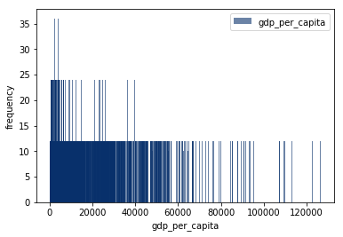
Histogram of gdp_per_capita:
From the histogram it is clear that the frequency decreased as the gdp value increased. Which indicates the less number of developed countries compared to developing/ underdeveloped countries.

Slide 8
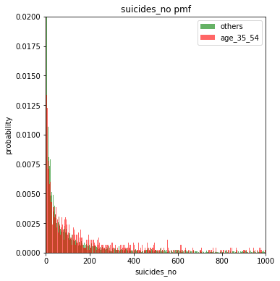
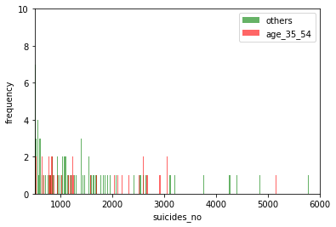
suicides_no pmf: Dividing the data into two groups according to their age. age_35_54 and others.
From the data I have observed that suicide number is higher in age_35_54. pmf and histograms confirms that. As the suicide number increases the probability of age_35_54 also increased.

Slide 9
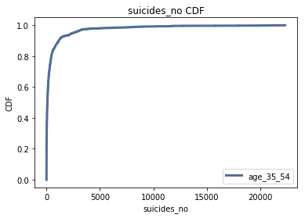
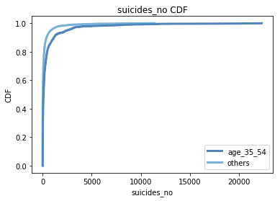
suicides_no CDF:
Left figure shows the CDF for suicides_no for age_35_54. Right figure shows the comparison between CDF of age_35_54 and others. From the plots we can conclude that 90% suicide numbers are below 5000. For lower number of suicide numbers other age group is prominent. For suicide numbers higher than 5000, both groups are almost similar.

Slide 10
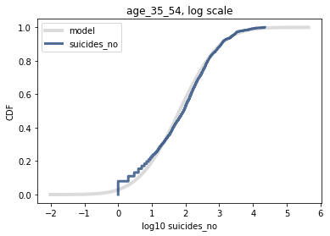
The lognormal distribution:
If a sample is approximately lognormal and you plot its CDF on a log-x scale, it will have the characteristic shape of a normal distribution. To test how well the sample fits a lognormal model, you can make a normal probability plot using the log of the values in the sample. I want to apply log transformation to reduce the skewness of the feature but it is giving an error value because feature has zero values. So i have used log(x+1) transformation. From the graph it is clear that the data follows the log normal distribution except at the lower end.

Slide 11
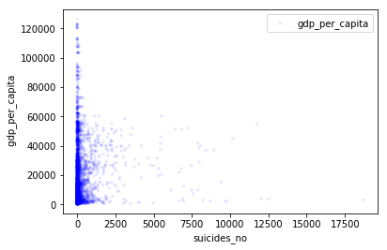
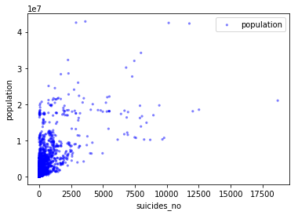
Scatter plots:
Fig.1
Fig.2
Fig.1 shows the scatter plot between suicides_no and gdp_per_capita. From the figure I couldn’t find any correlation between the variables. The correlation coeff. is 0.1 which is very low which means there is very weak relation between the variables.
Fig.2 shows the scatter plot between suicides_no and population. There is positive correlation between the variables is visible from the plot. The correlation coeff. is 0.76 which means there is strong positive correlation between the variables.

Slide 12
Hypothesis testing:
Permutation test:
We assume that there is no difference between age_35_54 and others. That is null hypothesis. Based on that assumption, we compute the probability of the apparent effect. That’s the p-value. To compute the p-value of an observed difference in means, we can assume that there is no difference between the groups and generate simulated results by shuffling the data. If the p-value is low, we conclude that the null hypothesis is unlikely to be true.
As the p-value is 0, we can conclude that our the null hypothesis is not true. That means there is difference in suicides_no in age_35_54 group and others.

Slide 13
Multiple regression:
The goal of regression analysis is to describe the relationship between one set of variables, called the dependent variables, and another set of variables, called independent or explanatory variables. Here we are using more than one explanatory variable so it’s multiple regression.
Here I am using the suicides_no as the dependent variable and population and HDI_for_year as the explanatory variables.
formula = 'suicides_no ~ population + HDI_for_year'
model = smf.ols(formula, data = suicide_data)
results = model.fit()
results.summary()
𝑅2 value for this model is 0.495 and the p-values are 0. Which means there is a good relationship between the dependent variable and the explanatory variables. As the p values are 0, we can say that this model is statistically significant. So we can conclude that together the variables population and HDI_ for _year contributes the variation in the suicides_no.

Slide 14
Summary:
From the analysis we can conclude that :
There is no correlation between suicides number and GDP.
I have observed that more number of suicide cases are in the age group of 35 – 54 and the pmfs and histograms confirms it.
From the regression analysis we can conclude that population and HDI are the two explanatory variables contributes the 50% variation in the suicide numbers.
What are the other variables contributing the suicides number completely is not known at this point. Once we understand the complete information, we can take necessary steps to prevent or atleast minimize the number of suicide cases.
THANK YOU

